Slide 1

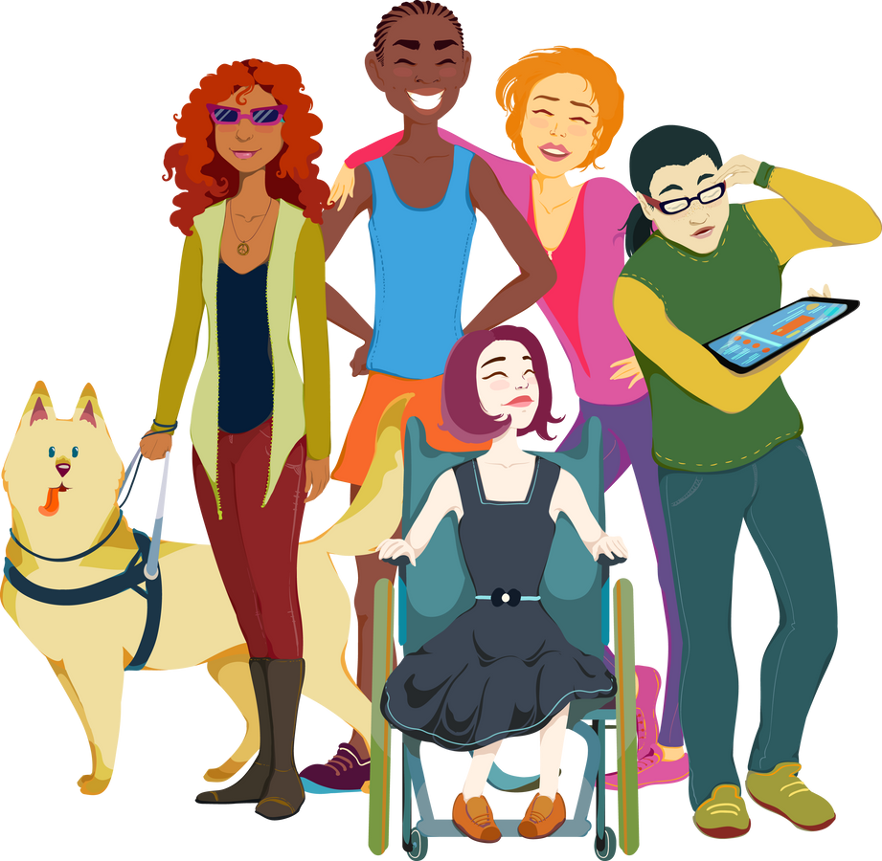
The PEAL Center
Parent Education and
Advocacy Leadership
Serving all 67 counties throughout Pennsylvania
www.pealcenter.org

Slide 2
Our Mission
The mission of the PEAL Center is to educate and empower families to ensure that children, youth and young adults with disabilities and special health care needs lead rich, active lives as full members of their schools and communities.

Slide 3

Objectives for Today
Hear from self-advocate about the importance of promoting advocacy skills in youth
Find out how PEAL educates and empowers families, youth, young adults, and professionals
Learn about PEAL resources

Slide 4


How We Assist
Educate and empower families, youth and young adults up to age 26, and professionals who work with them
Equip with the tools needed to advocate for their children and themselves
Offer guidance in education and ​healthcare systems
Develop informed decision makers​

Slide 5

PEAL Center Services
Outreach
Resources
Individual Assistance
Training
Leadership Development
Partnerships

Slide 6

PEAL Outreach
Reach families, youth/young adults, and professionals
Engage underserved communities
Share information about PEAL and statewide services
Network with organizations
Build community connections
Interact on social media

Slide 7

PEAL Resources
Tools and Materials
Develop and identify tools and materials
Available Resources
Bi-weekly eBlasts
Social media
PEAL Website
Community calendar
PA Planning for the future Transition Checklist

Slide 8
Individual Assistance:
INCLUSION
  PEAL provides individual assistance to families, youth and young adults, including help with evaluations, IEPs and 504 plans, healthcare, social participation, ADL’s, etc.
  Understand their rights and advocate for themselves​
  Be included & educated with high expectations at school and in their community​
  Access high quality, coordinated ​health care
  Assistance available in Spanish ​and other languages

Slide 9




Partnerships
Build bridges across organizations and systems
Education
Advocacy and family groups
State, local and national agencies
Healthcare
Connecting supports to strengthen community inclusion
Help effectively access services
Improve person-centered outcomes

Slide 10
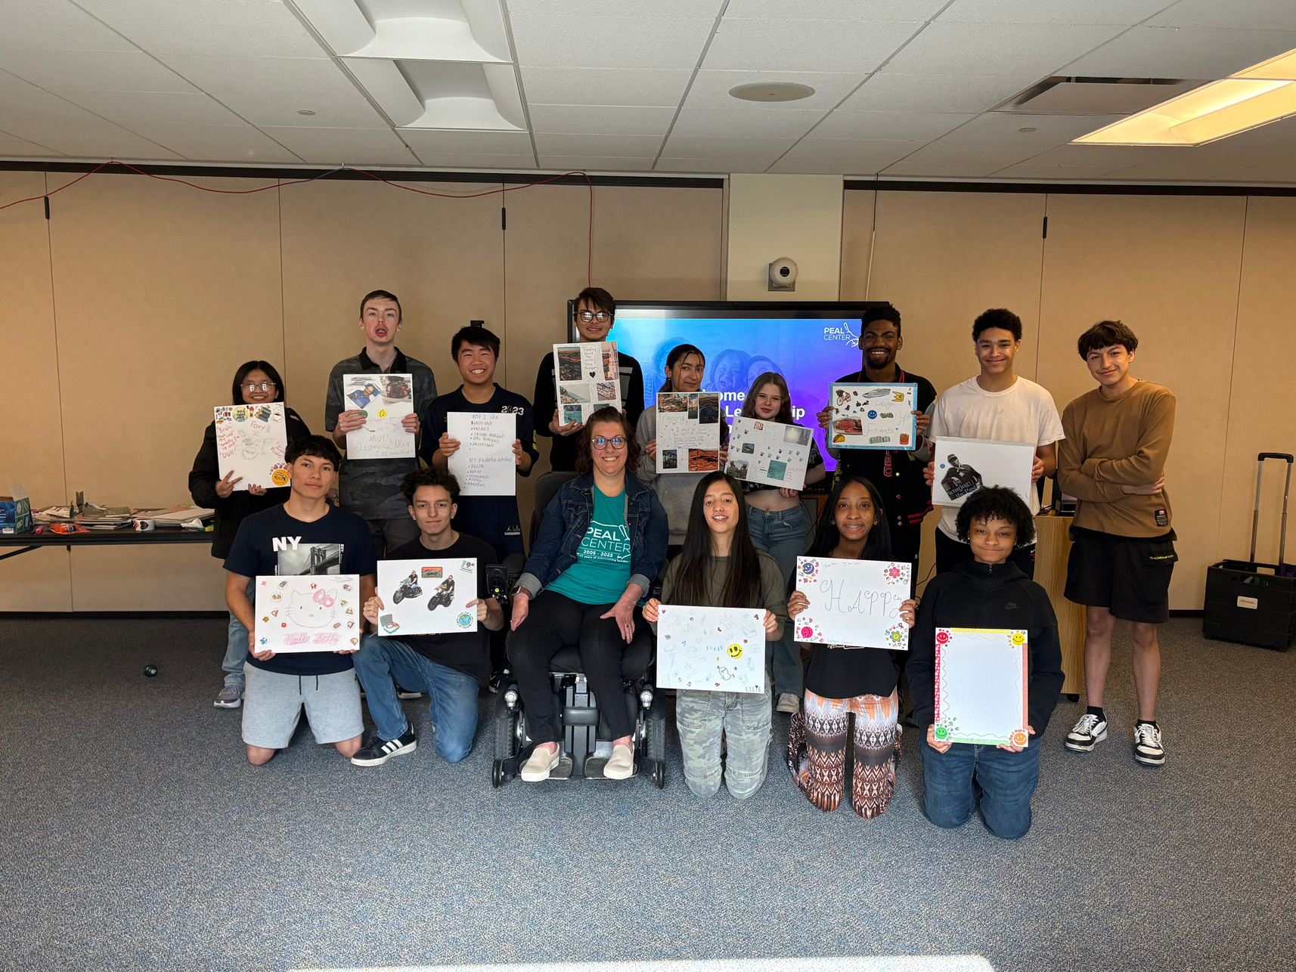
PEAL Youth Programs
Webinars on topics of interest
Young people throughout PA can join online
and learn about employment, social skills, self-advocating skills, helpful resources and more.
Youth Leadership Academies (YLA)
YLAs provide participants with an opportunity to gain self-awareness and confidence, learn how to become a leader, connect with peers and community leaders and discover helpful resources in their communities​.

Slide 11
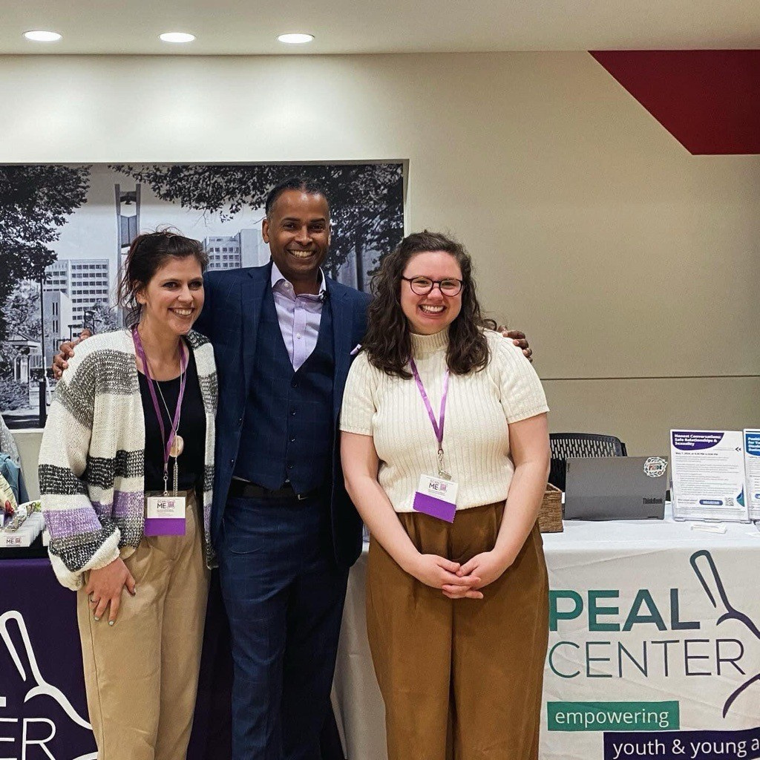
Training
Provide training to families, youth/young adults, and professionals
Build knowledge of best practices and develop skills for navigating special education, health care, and transition to adulthood​
Offer trainings in Spanish for families and caregivers

Slide 12
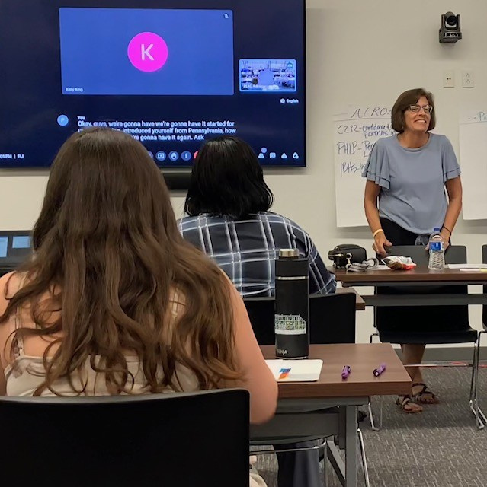
Leadership Development
Opportunity to develop skills to influence system-wide change
Learn about local county, state and federal systems, services and policy
Participate on decision making groups

Slide 13
21 and Able
PEAL Center’s 21 and Able Project helps young adults with disabilities transition smoothly from the last day of high school to the first day of adult life.
PEAL works with families to:
Provide drop-in sessions for support, information
and training
Connect families to the community supports and services
they need
Educate policymakers about the needs of young adults
in transition to adulthood
Notes:
21 an Able helps by increasing employment, housing opportunities and other support. 21 and Able has recently gone statewide in Pennsylvania

Slide 14
Elevatus Trainings
PEAL offers trainings for families, professionals, and young people to learn more about relationships and sexuality for young people with disabilities.
Honest Conversations: Safe Relationships & Sexuality
A training for parents & caregivers
Positive Relationships for Young People with Disabilities: Friends, Dating, and Beyond
Parents register their young person to participate independently in sessions covering relationships, dating, consent, and more

Slide 15
Family-to-Family Health
Information Centers
Family-staffed organization that provide support, information, resources, and training around health issues to help families of children and youth with special health care needs (CYSHCN) and the professionals who serve them.
Staffed by family members who have experience navigating health care services and programs
Evidence-based/informed; ensure health equity; are whole-person focused; and are innovative and collaborative

Slide 16







PEAL on Social Media
Follow PEAL on social media for the latest trainings, events, information and more!
www.facebook.com/pealcenter
www.instagram.com/pealcenter
www.linkedin.com/company/the-peal-center
linktr.ee/pealcenter
www.youtube.com/@PEALCenter

Slide 17
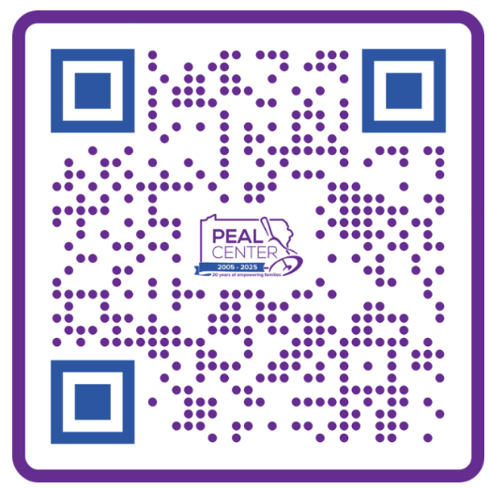



Evaluation
Scan QR code for PEAL evaluation
Open the Camera app on your phone.
Point the camera at the circle.
Tap the screen to open the page.

Slide 18


Thank You!
www.pealcenter.org
info@pealcenter.org
1-866-950-1040

